Slide 1
Examination of Domestic Economic Impact of the US-China Trade War by Analyzing Stock Market Fluctuations with Unsupervised Machine Learning.
Xiangyang Meng
M.S. of Information Technology, School of Business and Technology
Mentor: Dr. Michelle Liu, School of Business and Technology

Slide 2
Research scope
Stock market is "an anchor" to understand the economic impacts.
Every known and influential information reflects on stock prices immediately.
Most achievable
Real-time data
Objective and quantitative method to categorize and analyze stock market fluctuation.
Unsupervised Machine Learning
30 essential dates (June 28, 2016 - October 10, 2019)
4779 stocks

Slide 3
30 essential dates
June 28th, 2016 S&P 500: +1.78%
March 31th, 2017 S&P 500: -0.23%
April 7, 2017 S&P 500: -0.08%
July 19, 2017 S&P 500: +0.54%
Aug. 14, 2017 S&P 500: +1.00%
Jan. 17, 2018 S&P 500: +0.94%
Jan. 22, 2018 S&P 500: +0.81%
March 8, 2018 S&P 500: +0.45%
April 2, 2018 S&P 500: -2.23%
April 3, 2018 S&P 500: +1.26%
April 4, 2018 S&P 500: +1.16%
June 15, 2018 S&P 500: -0.10%
July 10, 2018 S&P 500: +0.35%
Aug. 1, 2018 S&P 500: -0.10%
Aug. 7, 2018 S&P 500: +0.28%
Aug. 23, 2018 S&P 500: -0.17%
Sept. 7, 2018 S&P 500: -0.22%
Sept. 24, 2018 S&P 500: -0.35%
Dec. 1, 2018 S&P 500: +1.09%
Feb. 24, 2019 S&P 500: +0.12%
May 5, 2019 S&P 500: -0.45%
May 8, 2019 S&P 500: -0.16%
June 18, 2019 S&P 500: +0.97%
June 29, 2019 S&P 500: +0.77%
Aug. 1, 2019 S&P 500: -0.90%
Aug. 13, 2019 S&P500: +1.5%
Aug. 23, 2019 S&P 500: -0.1%
Sept. 20, 2019 S&P 500: -0.53%
Sept. 23, 2019 S&P 500: -0.01%
Oct. 7, 2019 S&P 500: -0.46%
Retrieved from https://www.reuters.com/article/us-usa-trade-china-timeline/timeline-key-dates-in-the-u-s-china-trade-war-idUSKBN1ZE1AA

Slide 4
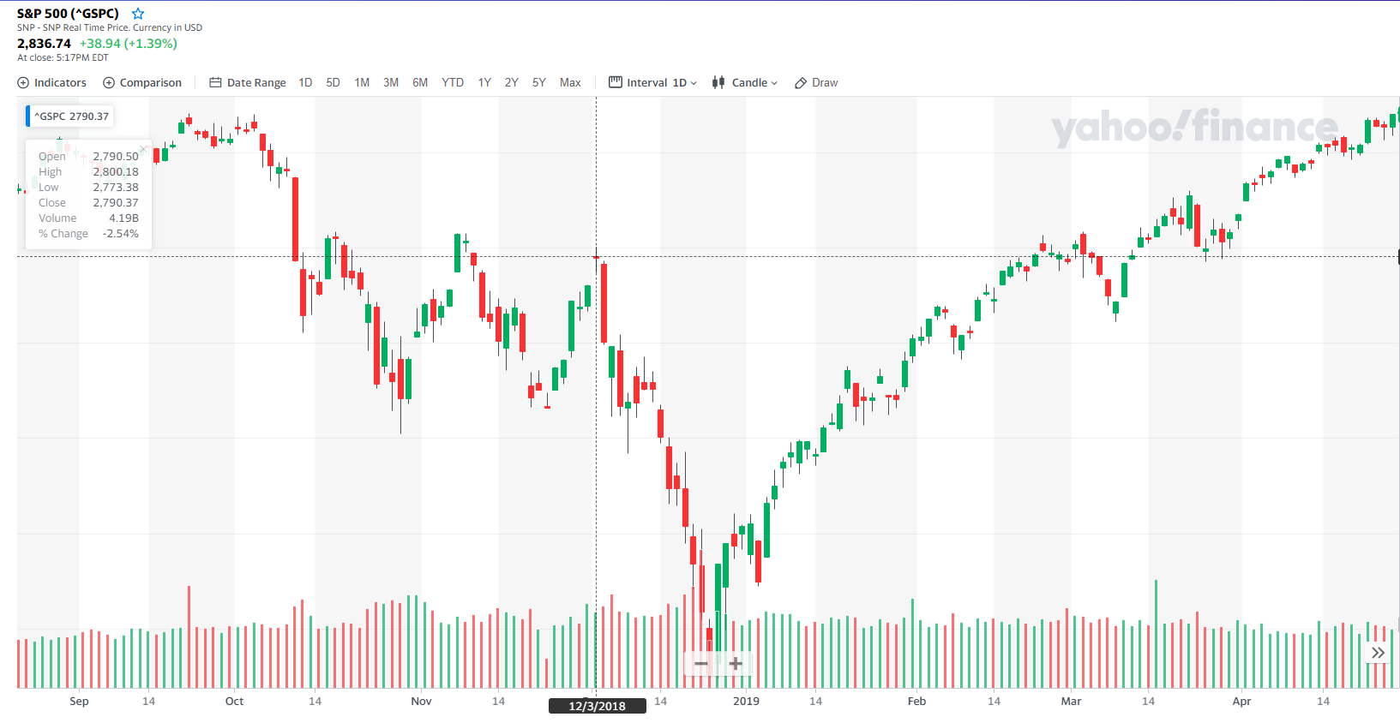
December 1: The planned increases in tariffs were postponed.
S&P 500 +1.09%
Afterwards, people found new agreement cannot be reach

Slide 5
Discipline-appropriate methods used
3 Phases
Data collection and cleaning
Training data through unsupervised machine learning
Analyzing clusters and trend

Slide 6
Phase 1: Data collection and cleaning
Collected historical stock data through Alpha Vantage API
Sorted out stocks registered before June 28, 2016 and closed after October 7, 2019
2555 NYSE stocks + 2524 NASDAQ stocks

Slide 7
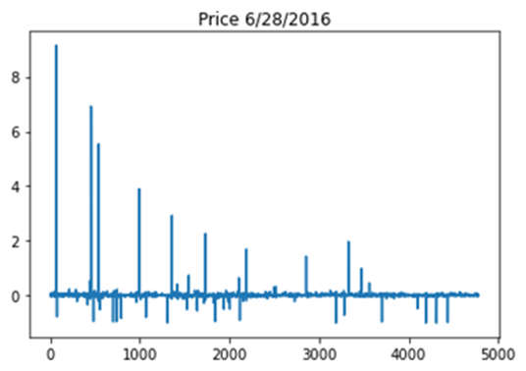
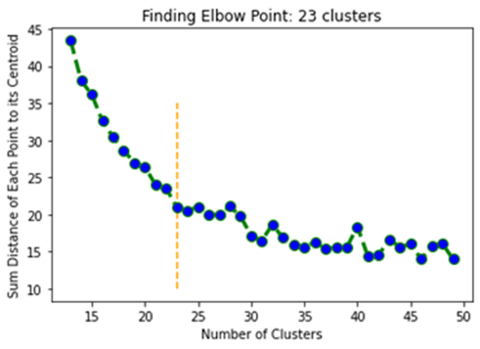
Phase 2: Training data through unsupervised machine learning
K-Means Algorithm
Elbow method
Unsupervised machine learning on each essential date
Stock price fluctuation on June 28, 2016
Elbow Method finds out the optimal number of clusters

Slide 8
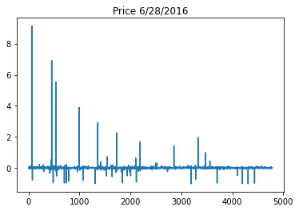
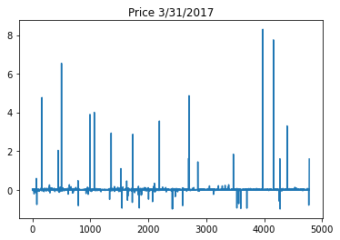
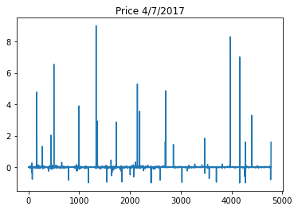
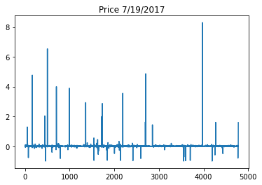
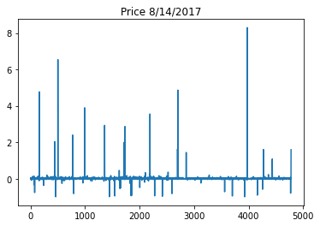
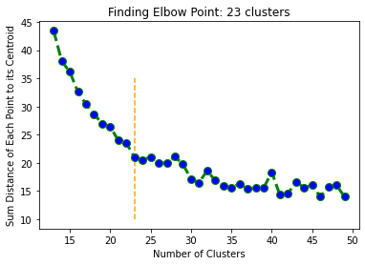
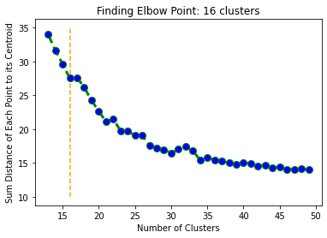
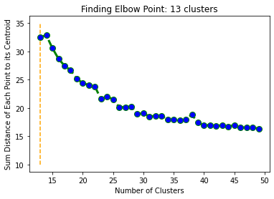
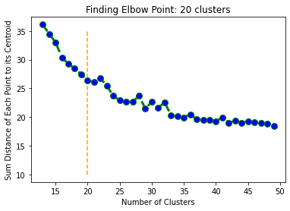
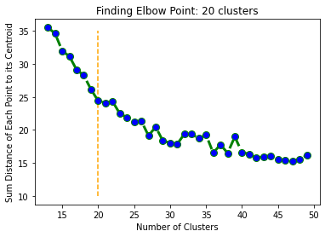
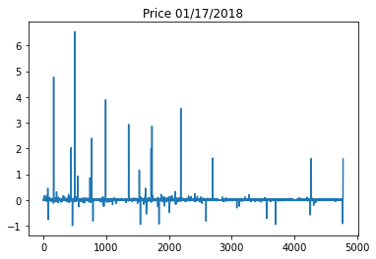
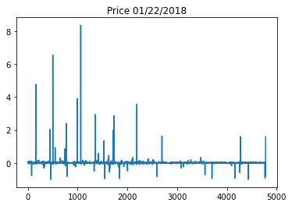
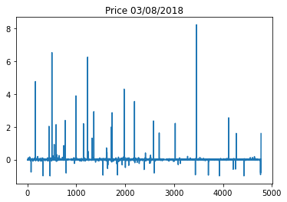
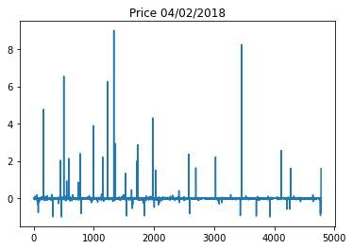
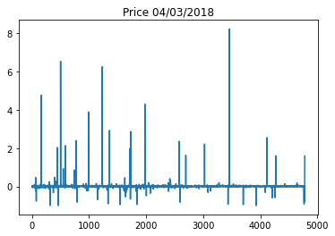
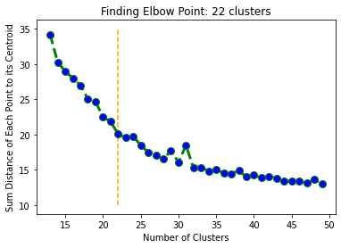
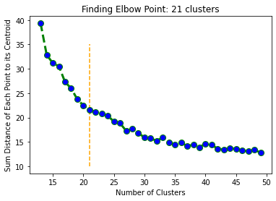
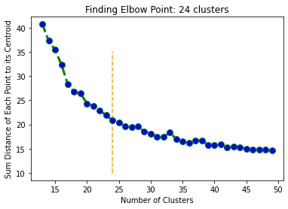
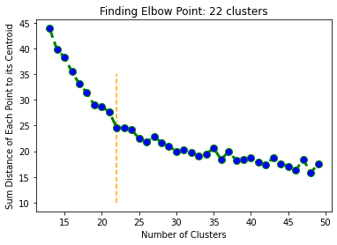
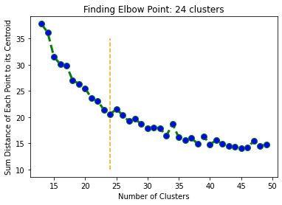

Slide 9
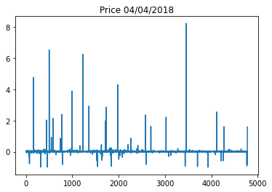
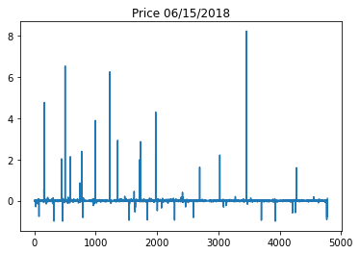
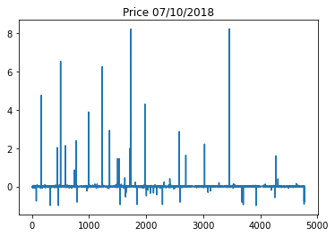
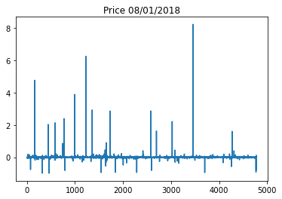
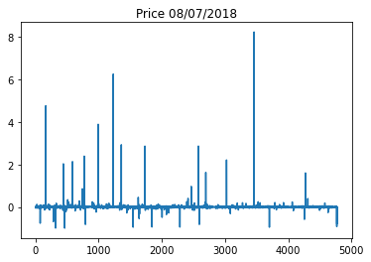
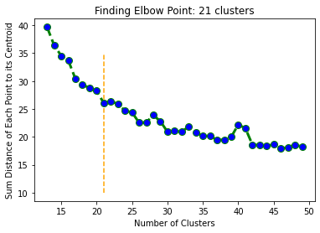
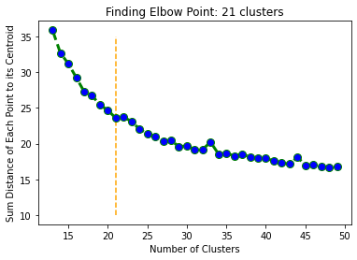
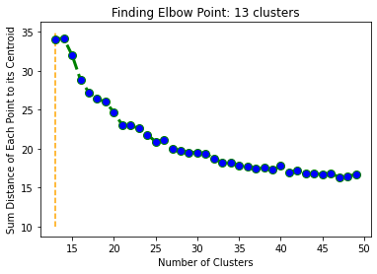
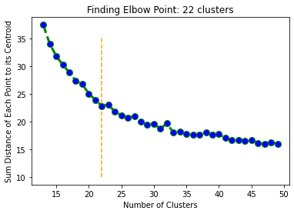
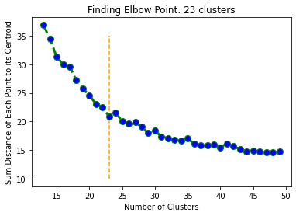
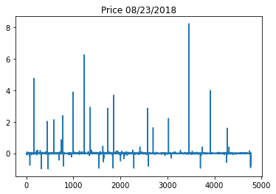
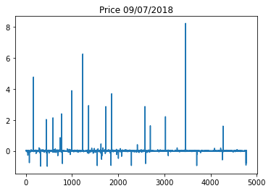
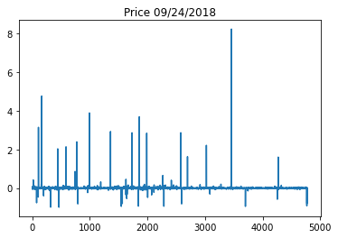
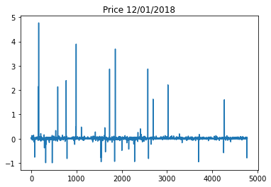
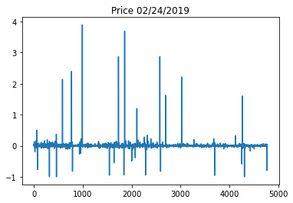
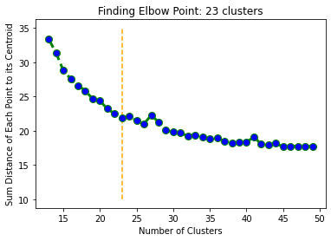
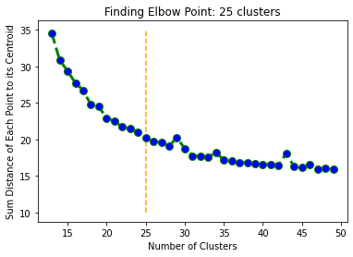
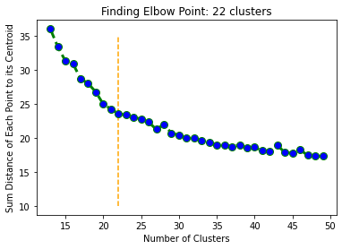
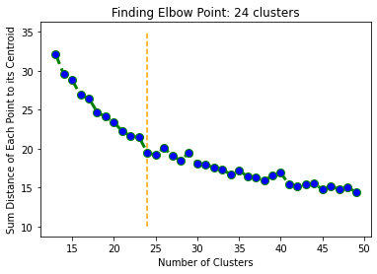
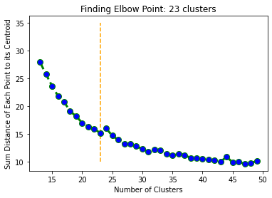

Slide 10
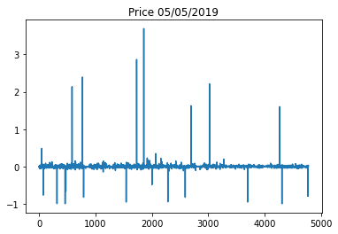
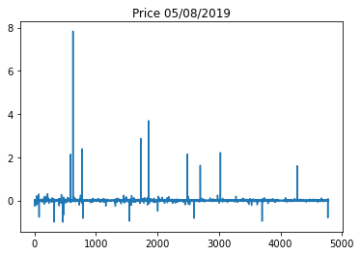
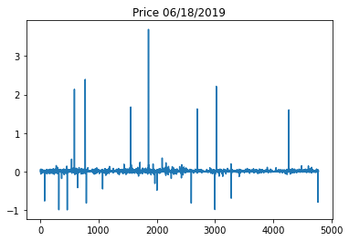
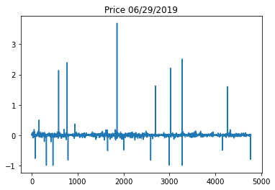
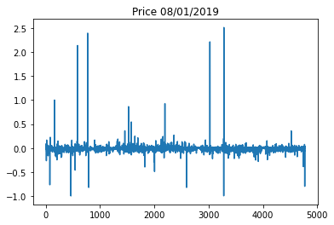
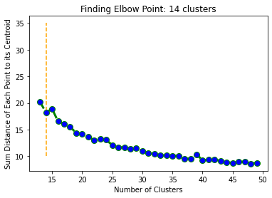
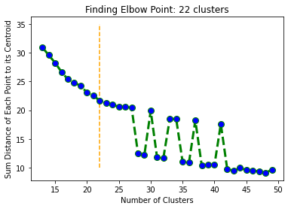














Slide 11


Slide 12
Phase 3: Analyzing clusters and trend Clustering result on each essential date
No | Date | S&P 500 | Result: Number of Large Clusters (>100 stocks)
1 | 6/28/2016 | +1.78% | 9
2 | 3/31/2017 | -0.23% | 6
3 | 4/7/2017 | -0.08% | 5
4 | 7/19/2017 | +0.54% | 9
5 | 8/14/2017 | +1.00% | 8
6 | 1/17/2018 | +0.94% | 9
7 | 1/22/2018 | +0.81% | 8
8 | 3/8/2018 | +0.45% | 9
9 | 4/2/2018 | -2.23% | 9
10 | 4/3/2018 | +1.26% | 10
11 | 4/4/2018 | +1.16% | 9
12 | 6/15/2018 | -0.10% | 10
13 | 7/10/2018 | +0.35% | 4
14 | 8/1/2018 | -0.10% | 10
15 | 8/7/2018 | +0.28% | 9
16 | 8/23/2018 | -0.17% | 9
17 | 9/7/2018 | -0.22% | 11
18 | 9/24/2018 | -0.35% | 10
19 | 12/1/2018 | +1.09% | 13
20 | 2/24/2019 | +0.12% | 11
21 | 5/5/2019 | -0.45% | 7
22 | 5/8/2019 | -0.16% | 12
23 | 6/18/2019 | +0.97% | 12
24 | 6/29/2019 | +0.77% | 10
25 | 8/1/2019 | -0.90% | 10
26 | 8/13/2019 | +1.5% | 7
27 | 8/23/2019 | -0.1% | 8
28 | 9/20/2019 | -0.53% | 15
29 | 9/23/2019 | -0.01% | 14
30 | 10/7/2019 | -0.46% | 12
The clustering result is similar to the industry classification of the stock market

Slide 13

Relationship between the price fluctuation of each cluster and the number of stocks in each cluster
When the U.S. firstly planned to counter unfair trade from China on June 28, 2016, more stock prices were increasing. There are more clusters of rising stocks.
This pattern indicates that people had the confidence for US winning the Trade War.
When China retaliated the first time on April 2, 2018, more stock prices were decreasing, showing that people were optimistic about China and Chinese manufacturers. There are more clusters of decreasing stocks.
The pattern is that the more the cluster decreased, the more stocks in the cluster.

Slide 14

Analyzing the three most positively influenced clusters when the U.S. decided to slap trade war against China on June 28, 2016

Slide 15

1st cluster
The top four industries :
Major Pharmaceuticals (58)
Major Banks (38)
Real Estate Investment (29)
Oil & Gas (23)

Slide 16

2nd cluster
The top four industries:
Major Banks (75)
Real estate Investment (64)
Major Pharmaceuticals (29)
Computer Software(29)

Slide 17

3rd cluster
The top four industries:
Major Pharmaceuticals (61)
Oil & Gas (24)
Major Banks (17)
Semiconductor (14)

Slide 18

Analyzing the three most negatively influenced clusters when China retaliated on April 2, 2018

Slide 19

1st cluster
The top four industries :
Major Pharmaceuticals (50)
Major Banks (34)
Industrial Machinery (22)
Oil & Gas (22).

Slide 20

2nd cluster
The top four industries:
Major Pharmaceutical (56)
Semiconductor (25)
Industrial Machinery (18)
Metal Fabrication (16)

Slide 21

3rd cluster
The top four industries:
Major Banks (91)
Real Estate Investment (33)
Major Pharmaceuticals (26)
Computer Software (26)

Slide 22
Top positively influenced industries on June 28, 2016
Top negatively influenced industries on April 2, 2018
Major Pharmaceuticals
Oil & Gas
Major Banks
Real Estate Investment
Semiconductor
Computer Software
Major Pharmaceuticals
Oil & Gas
Major Banks
Real Estate Investment
Semiconductor
Computer Software
Metal Fabrication

Slide 23
Summary of findings/creative work.
Research findings:
Clustered the stocks based on performance
Demonstrated that people ‘s expectations for the U.S. economy and the Chinese economy during the first stage of trade war.
Found out the most influenced industries
Major Pharmaceuticals
Industrial Machinery
Oil & Gas
Major Banks
Real Estate Investment
Semiconductor

Slide 24
Summary of findings/creative work. (cont.)
Creative work:
Combines the I.T. and business fields
Brings computer-based scientific methods into the analysis of the stock market
Demonstrates how to use the unsupervised machine learning tool to analyze government policies' impacts on the stock market

